Slide 1

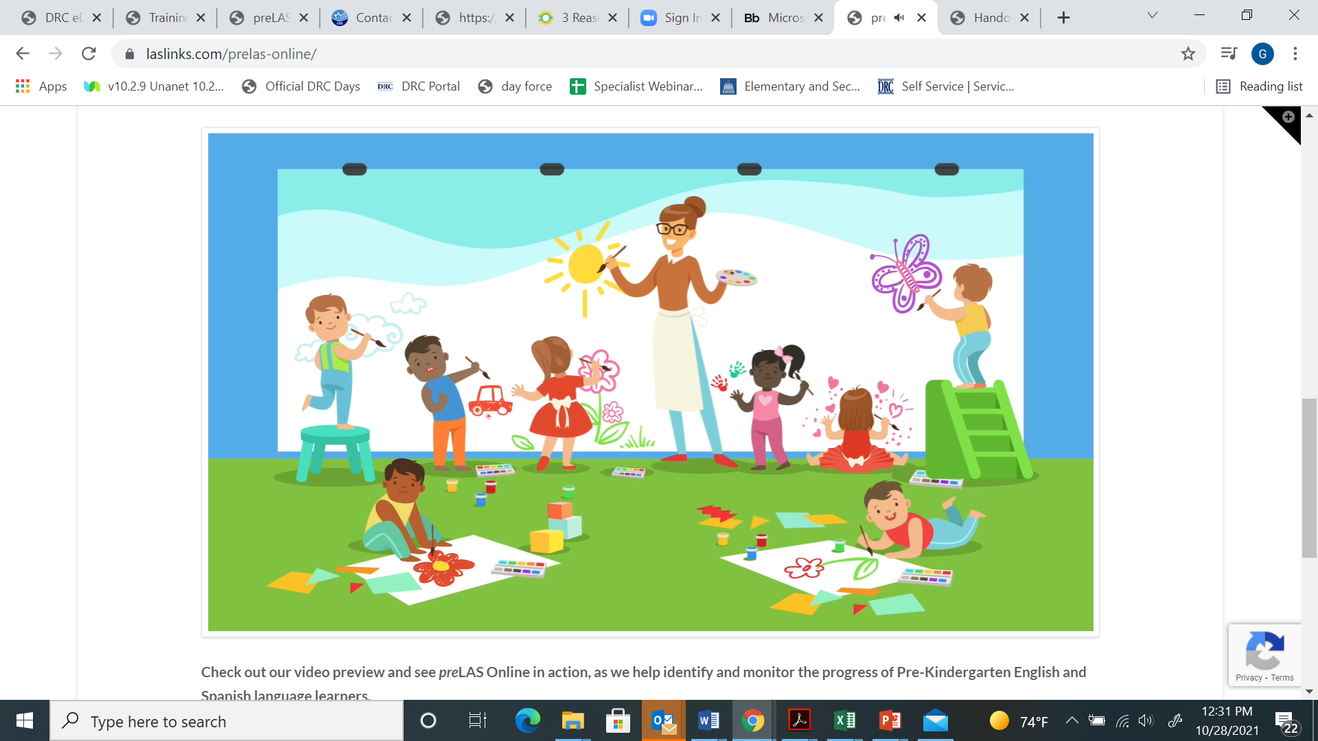

Jana Hilleren Genevieve Olvera Data Recognition Corporation
Promote equity by supporting all children in language and literacy development with preLAS

Slide 2

Before we get started…
Contact Information:
Jana Hilleren, jhilleren@datarecognitioncorp.com
Genevieve Olvera, golvera@datarecognitioncorp.com
Resources:
https://laslinks.com/prelas/
Video link: https://laslinks.com/prelas-online/
We would love to hear from you!
Please type your comments/responses/ideas in the chat box!

Slide 3
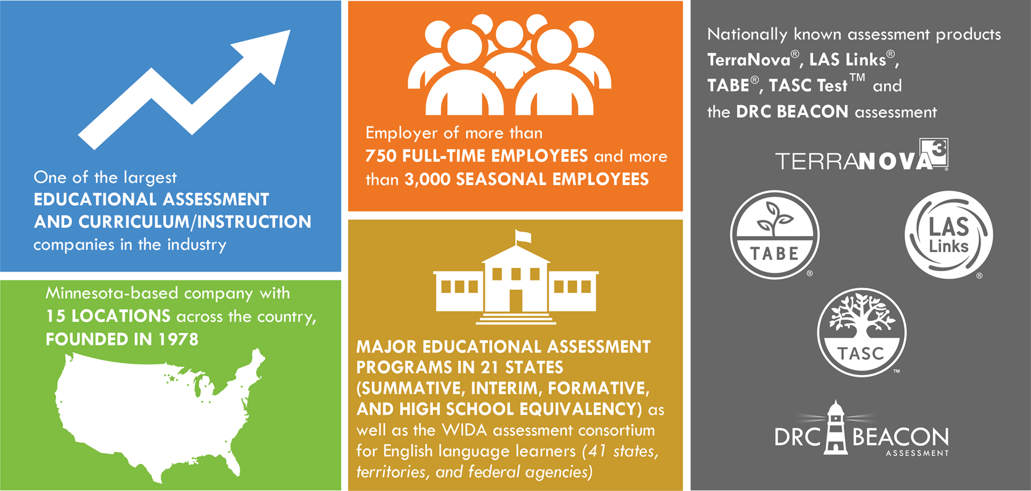
About Data Recognition Corporation

Slide 4


Topics
This session will explore the value of
focusing on language and literacy development
developing strong partnerships with families
reporting progress
preparation for Kindergarten
Spanish language and literacy development
Dual language measurement tools

Slide 5
Oral Language
Oral language lays the foundation for the reading and writing skills children will develop as they enter and progress through school. They will use oral language in all aspects of their education, in the classroom as they connect with their peers and teachers, and throughout their lives as they grow into adulthood. Oct 1, 2020
Oral language proficiency has a major impact on students. All standardized testing in the United States is done in academic or standard English, therefore, children whose personal language is not an academic language are at a disadvantage. Children need to be able to speak academic oral language in order to become successful learners and readers in the classroom while their personal language is still valued and maintained.

Slide 6

Literacy
Reading proficiency by the end of third-grade can predict a child’s success in school and in life (Donald Hernandez, 2011). Stephen Covey, an educator and author, states that we should, “Begin with the end in mind” (Covey, 1990). If we want to give our children the best chance to graduate high school and become successful contributors to society, we must start as early as possible in their young lives. We must give them a solid foundation in oral language to build upon.
The Importance of Oral Language for Literacy Success
Thursday, 01 Oct 2020
https://grapeseed.com/us/blog/the-importance-of-oral-language-for-literacy-success/

Slide 7
Reading Partners (https://readingpartners.org/blog/six-reasons-support-early-literacy/ )
Port Discovery (https://www.portdiscovery.org/news-room/3-reasons-early-literacy-skills-are-important-your-child)
“Experiences that help children talk, read, and write, help them progress on their path to literacy and help set them up for success in school and life”
“Early literacy development includes awareness of books and print, hearing and playing with sounds in words, the relationships between letters and sounds, vocabulary development”
“Early literacy development begins in the first three years of a child’s life and supports their future language development, reading, writing, and overall learning”
“students who can’t read proficiently by fourth grade are four times more likely to drop out of high school”

Slide 8
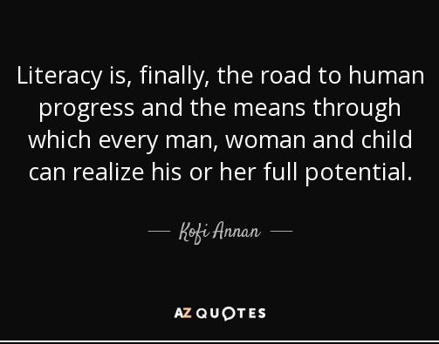


Slide 9
When it comes to language and literacy tools for your program, what are your greatest needs?

Slide 10
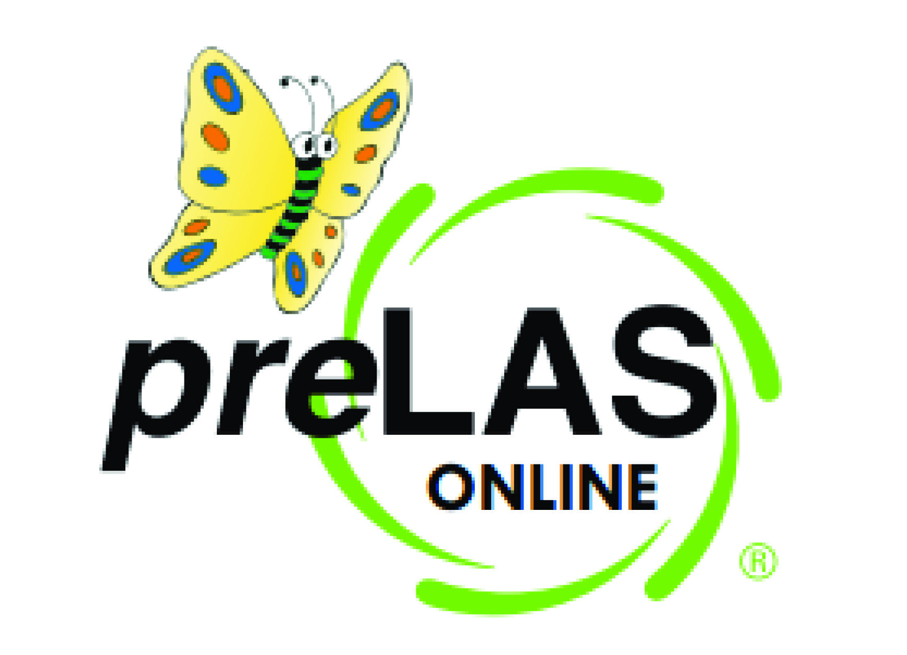
About preLAS
The preLAS is a 2-in-1 measure consisting of an Oral Language component and a Pre-literacy component available in both English and Spanish for preK3, preK4, and Kindergarten programs or students ages 3-6 years old.
Utilized in programs to:
Measure the developing language of all early learners
Based on results, programs can target activities to promote language and learning
Ensure students are progressing along the stages of language development
Report results to parents and Head Start administrators
Provide both language and pre-literacy information as students transition to Kindergarten classes/programs
PK and K Dual Language programs
Notes:
The preLAS is a language proficiency assessment consisting of an Oral Language component in English and Spanish for three-, four-, and five-year olds. Test results are used to: Identify and place English Language Learners (EL’s) in appropriate classroom settings and to measure the developing language of first-language learners of Spanish. The preLAS assessment is individually administered and takes approximately 15 minutes to administer.

Slide 11
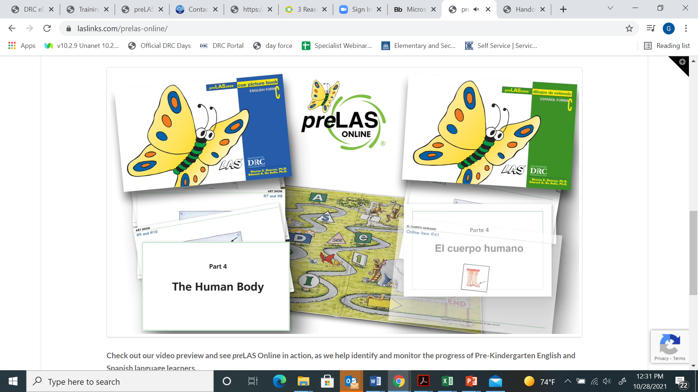
Component | Measures | # of items | Skills Measured
Simon Says Simón dice | Receptive Language | 10 | Ability to follow oral directions
Art Show Muestra de arte | Expressive Language | 10 | Ability to produce oral vocabulary and verb phrases at appropriate level of development
Say What You Hear Repetición de frases | Receptive and Expressive Language | 10 | Ability to repeat specific morphological and syntactical features Ability to demonstrate internalized command of grammatical constructions
The Human Body El cuerpo humano | Expressive Language | 10 | Ability to produce oral vocabulary and verb phrases at appropriate level of development
Tell A Story Contando cuentos | Receptive and Expressive Language | 2 | Ability to produce complete sentences Ability to retell a simple narration with picture cues Ability to be understood by adults
Oral Language
Component

Slide 12
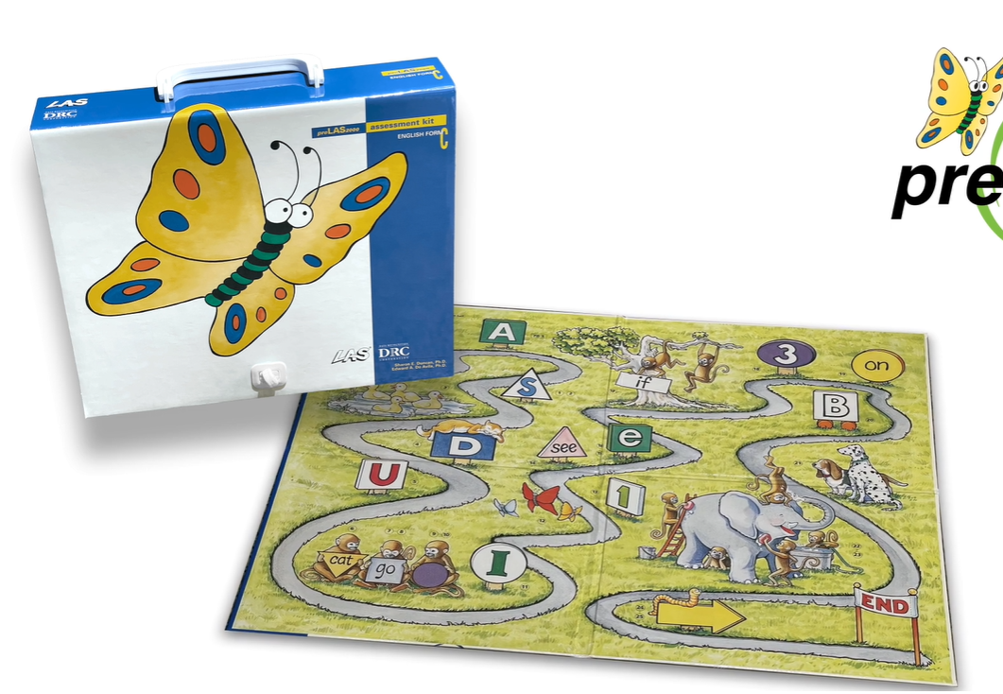
Pre-Literacy Component | Early Literacy Skills
Letter recognition Reconocer las letras | Ability to identify uppercase and lowercase letters
Number recognition Reconocer los numeros | Ability to identify numbers
Number concepts Reconocer conceptos numericos | Ability to conceptualize numbers
Color recognition Reconocer colores | Ability to recognize primary and secondary colors
Recognition of geometric shapes Reconocer formas geométricas | Ability to recognize shapes
Spatial relationships Comprender relaciones espaciales | Ability to identify position relationships such as in front of, behind, underneath, etc
Recognition of sight words Descodificar palabras | Ability to identify common sight words
Dictation of sight words Codificar palabras dictadas | Writing own name and age and sight words
Pre-Literacy
Component
Notes:
The preLAS is a language proficiency assessment consisting of an Oral Language component in English and Spanish for three-, four-, and five-year olds. Test results are used to: Identify and place English Language Learners (EL’s) in appropriate classroom settings and to measure the developing language of first-language learners of Spanish. The preLAS assessment is individually administered and takes approximately 15 minutes to administer.

Slide 13
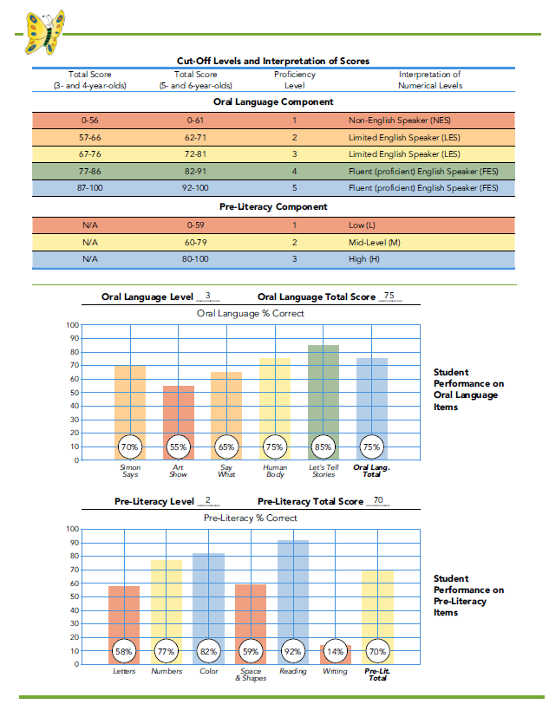

Reporting Results

Slide 14

Oral Language

Slide 15
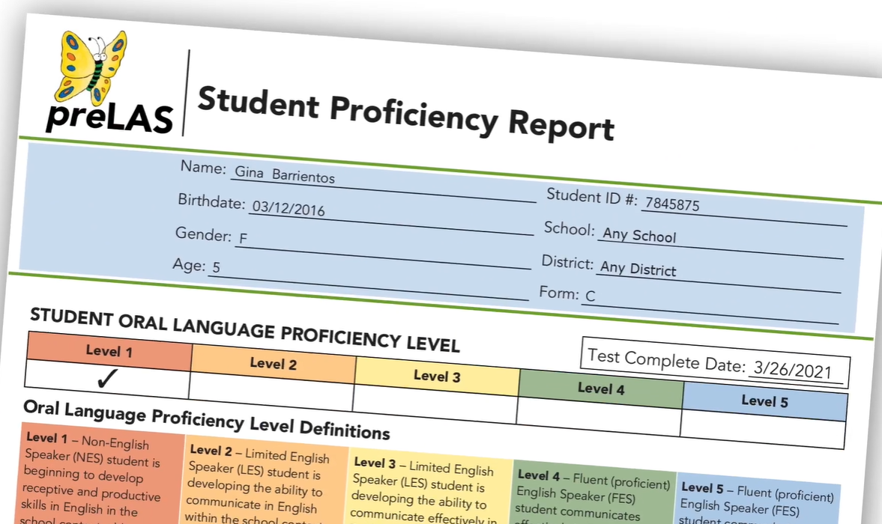
What benefit do you see for utilizing total scores when reporting on student progress?

Slide 16
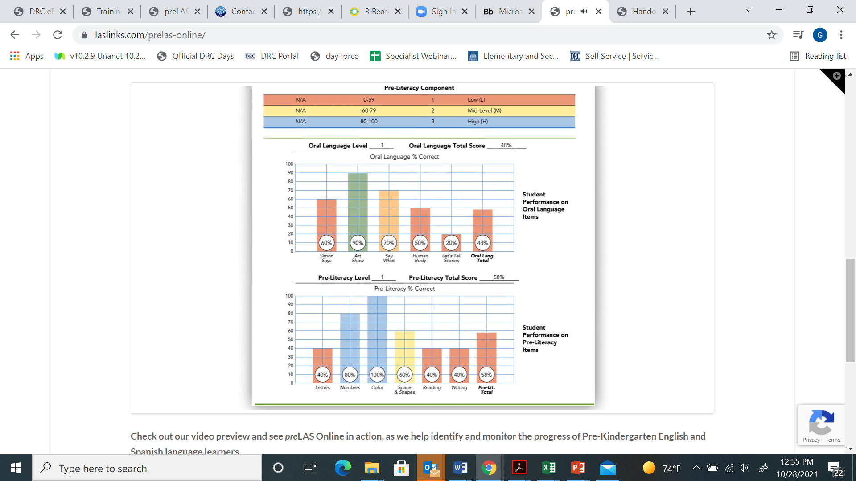
Activity: Oral Language Analysis
What does the oral language report illustrate for this student?

Slide 17
Activity: Pre-Literacy Analysis
What does the pre-literacy report illustrate for this student?

Slide 18
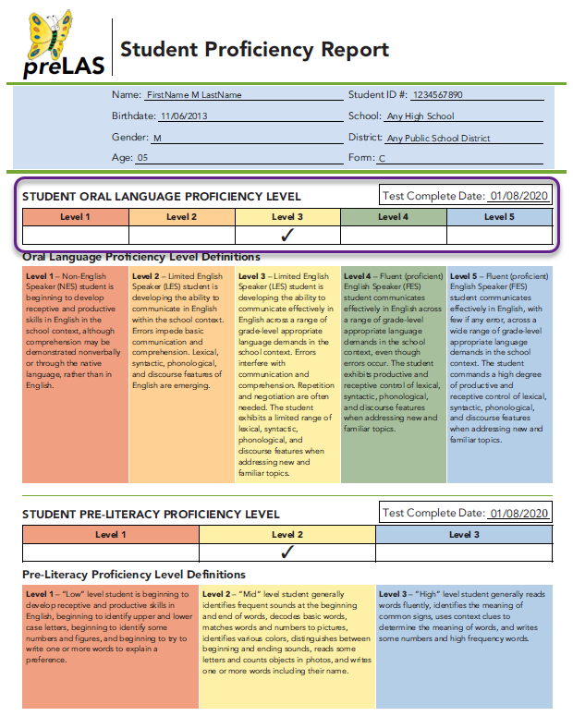
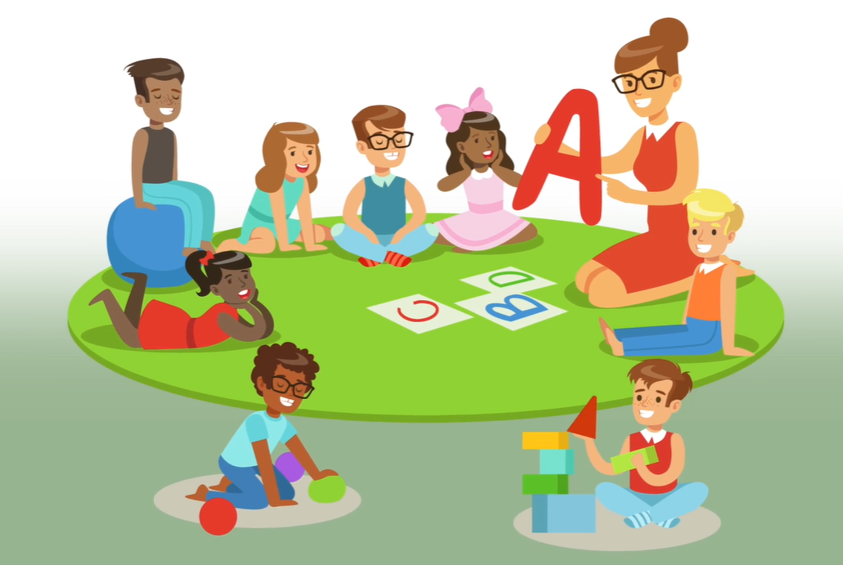
Reporting Results
Notes:
For preLAS, per the State and Federal Guidelines:
If a student receives a 1, 2 or 3 Oral Language proficiency level, they are to be classified as an English learner (EL).
If a student receives a 4 or 5 Oral Language proficiency level – they are to be considered Fluent - not to be identified as an English learner.

Slide 19
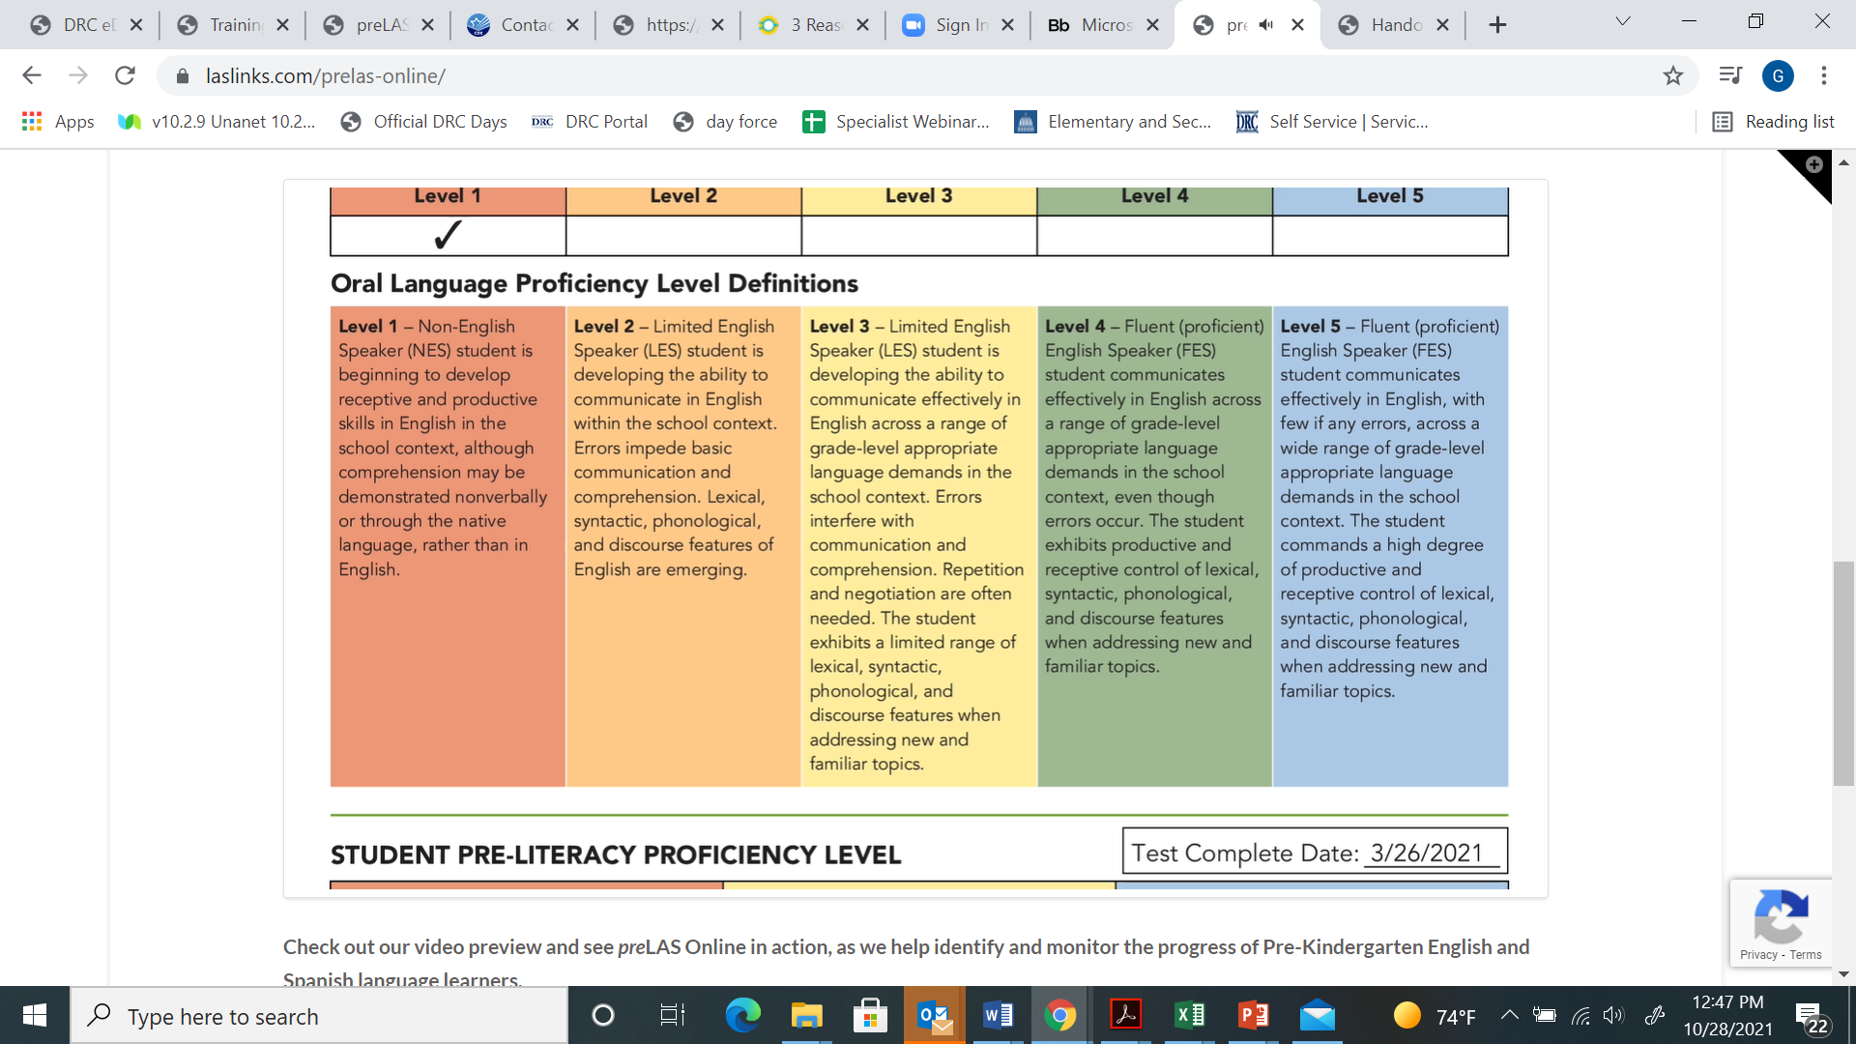
Reporting Language and Literacy Results
Notes:
For preLAS, per the State and Federal Guidelines:
If a student receives a 1, 2 or 3 Oral Language proficiency level, they are to be classified as an English learner (EL).
If a student receives a 4 or 5 Oral Language proficiency level – they are to be considered Fluent - not to be identified as an English learner.

Slide 21
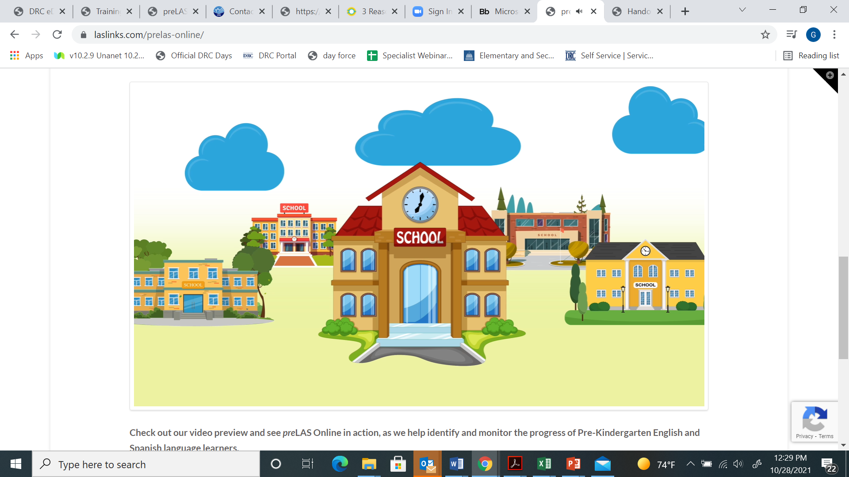
What data do you find most useful in these reports?
What data would parents/guardians find most useful in these reports?

Slide 22
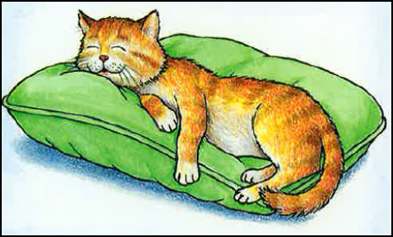

Language and Literacy Tools
Language Component can be given in different sessions or in any order
Paper/pencil and online* available
Easy scoring
Results are immediate
With preLAS Online score reports are available for printing
Notes:
The preLAS is a language proficiency assessment consisting of an Oral Language component in English and Spanish for three-, four-, and five-year olds. Test results are used to: Identify and place English Language Learners (EL’s) in appropriate classroom settings and to measure the developing language of first-language learners of Spanish. The preLAS assessment is individually administered and takes approximately 15 minutes to administer.

Slide 23
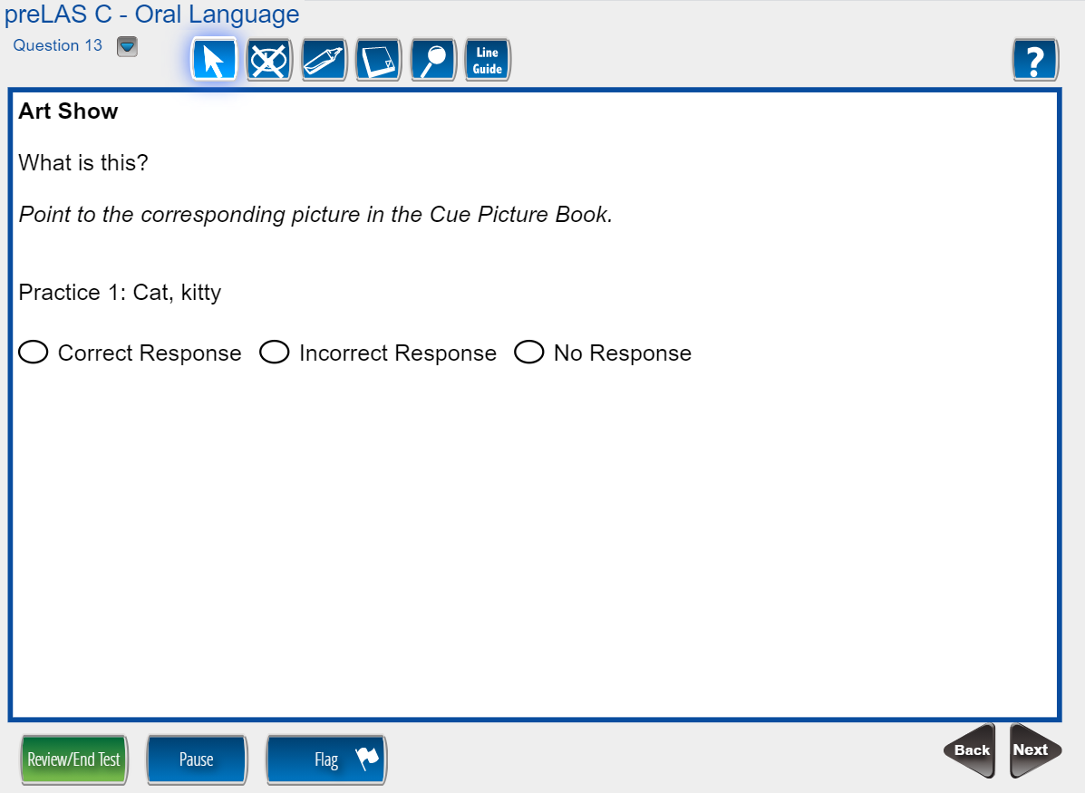
Paper/Pencil or Online Format
Notes:
For Art show use the Cue Picture Book, point to each picture and ask “what is it” for the first 4 pictures then “what is it” and “what is it used for” for the last 3 pictures (6 items).
If the student answers in a language other than English, you say, “remember, tell me in English, what is this?” – this serves as the second and last time to prompt for this item. Even if the student’s response in another language is correct, it is not counted as correct since it is not in the language of the test being administered.

Slide 24

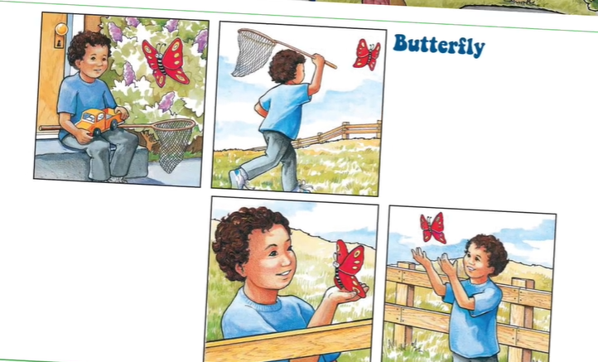
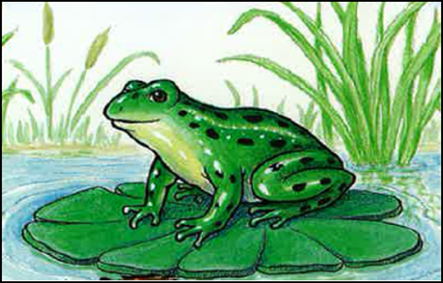
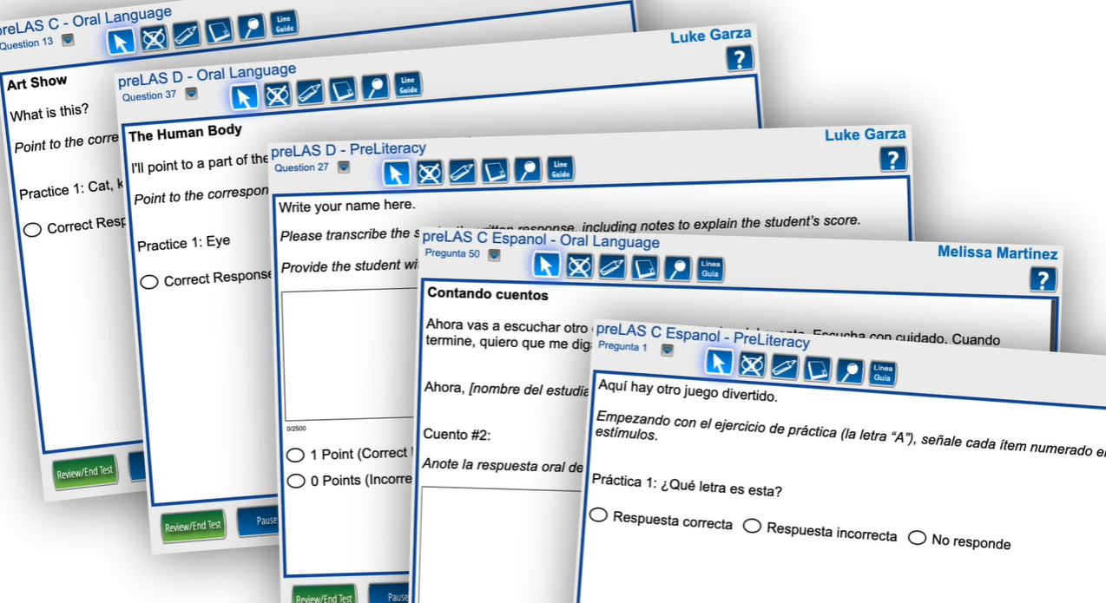


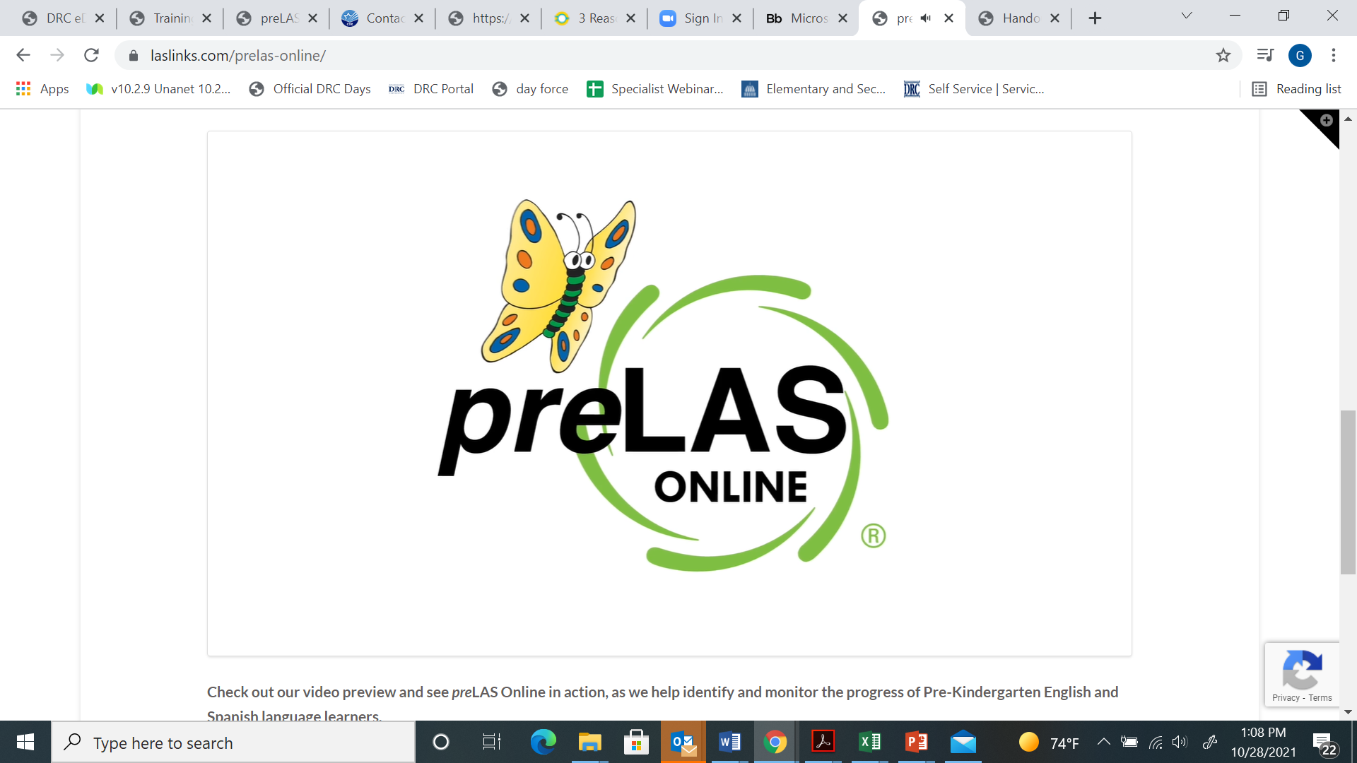
Colorful and Engaging
Notes:
Locate the preLAS Scoring practice items on page 4 of your handouts and worksheets.
ONSIGHT TRAINER: Read one at a time allowing group to read each answer and have them call out their answers. Use your answer keys for the rationale for each score.

Slide 25
Topics
This session will explore the value of
focusing on language and literacy development
developing strong partnerships with families
reporting progress
preparation for Kindergarten
Spanish language and literacy development
Dual language measurement tools

Slide 26

Contact Information:
Jana Hilleren, jhilleren@datarecognitioncorp.com
Genevieve Olvera, golvera@datarecognitioncorp.com
Thank you!

